Slide 1
Fake Twitter Accounts
Big Data Mining Term Project
By
Mukesh Badigineni [108998405]
Vineela Swathi [108998406]

Slide 2
Outline:
Data Set
Architecture
Rule set
Confusion Matrix
RandomForest Method
Conclusion

Slide 3
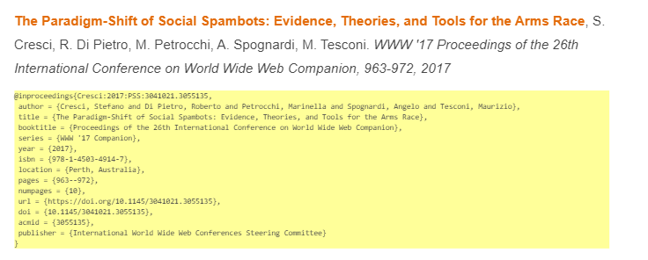
Data Set
http://mib.projects.iit.cnr.it/dataset.html
Data Set | Accounts | Tweets | Year
User | 3,474 | 8,3775,22 | 2011
Tweets | 3457 | 428,542 | 2011

Slide 4
Data_Set
Profile Analysis
Table Check List
R >50%
TimeLine Analysis
URL value
Relation Ship Analysis
ID Accuracy
Human or Bot

Slide 5
Three types of operations will be done on the Data_Set:
Profile Analysis:
Evaluating Camisani-Calzolari table of details algorithm.
ID’s are given points to corresponding check-list in the table.
Weightage value is to be calculated based on the given points.
TimeLine Analysis:
Based on a paper published on this topic and rules and check points furnished in the paper, this section is carried out
Analysing the tweet for present URL’s, hashtags, punctuations and phrases..
It will also search for particular account is linked to android, iPhone, foursquare or Instagram.
Relationship Analysis:
More than 90% tweets are re-tweets and links.
Friends/followers ratio will be calculated and compared with threshold value.
Comparing with the accuracy value of tweets / retweets ratio.

Slide 6
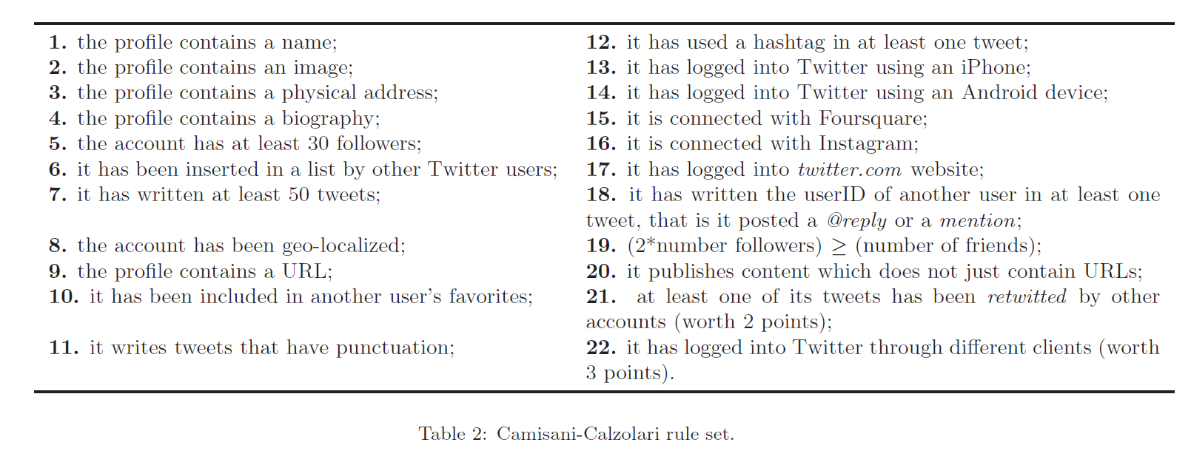
Camisani-Calzolari rule set

Slide 7
CLASS ‘A’
CLASS ‘B’
CLASS ‘C’
Attributes | ID 1 | ID 2
Name | 1 | 1
Address | 1 | 1
Geo location | 1 | 0
Profile URl | 1 | 1
Screen Name | 1 | 1
Contributors | 0 | 0
favorited | 1 | 0
Attributes | ID 1 | ID 2
Hash Tags | 1 | 1
Phrases | 1 | 1
URL’s | 0 | 1
Punctuations | 0 | 0
API Platform | - | -
Twitter.com login | 1 | 1
userID Tag’s | 1 | 0
Attributes | ID 1 | ID 2
(2*followers)>= (friends) | 2 | 0
Tweets / Retweets | 2 | 0
Third party client login using twitter | 2 | 0
Tweets without URL | 1 | 1
Features_list = [ ID1, ID2, ID3,…..,IDn ]

Slide 8
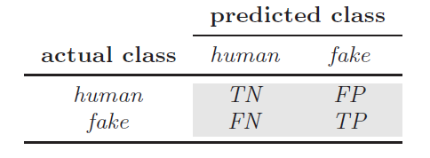
Confusion Matrix:
Sometimes even the Genuine accounts will be added into fake account list, in those scenario this confusion matrix is used as accuracy remainder.
True Positive (TP): the number of those fake followers recognized by the rule as fake followers.
True Negative (TN): the number of those human followers recognized by the rule as human followers.
False Positive (FP): the number of those human followers recognized by the rule as fake followers.
False Negative (FN): the number of those fake followers recognized by the rule as human followers.

Slide 9
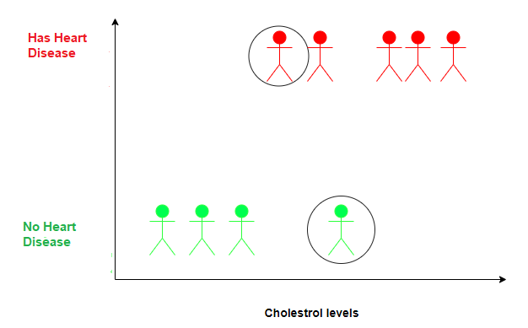
Area Under Curve:
Fake Accounts
Genuine Accounts
Fake Accounts
Graphs are plotted based upon the confusion matrix.
These graphs will determine the accuracy of our method.
Check List score

Slide 10
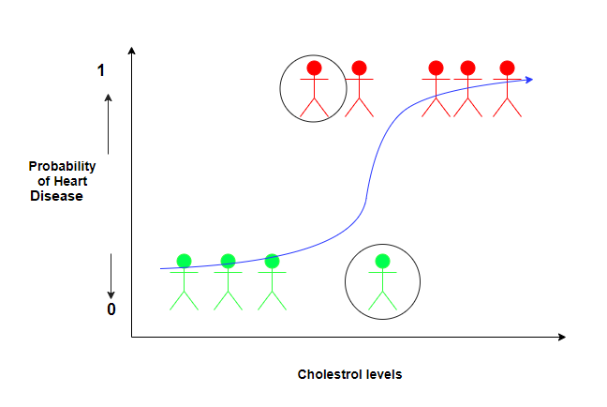
Probability
Genuine Accounts
Check List score

Slide 11
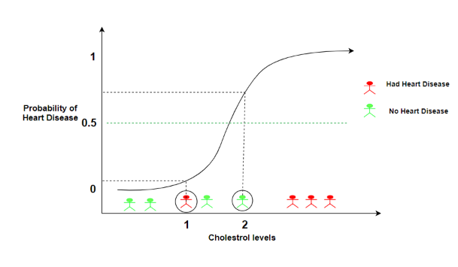
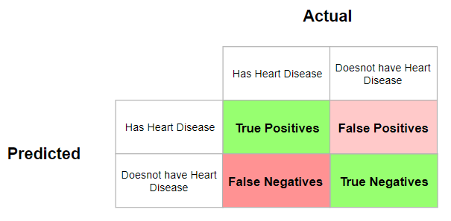
Genuine account
Probability of Genuine Accounts
Fake Account
Check List score
Genuine
Fake
Genuine
Fake
Genuine
Fake
Genuine
Genuine
Genuine
3
1
Fake
Fake
Fake
1
3

Slide 12
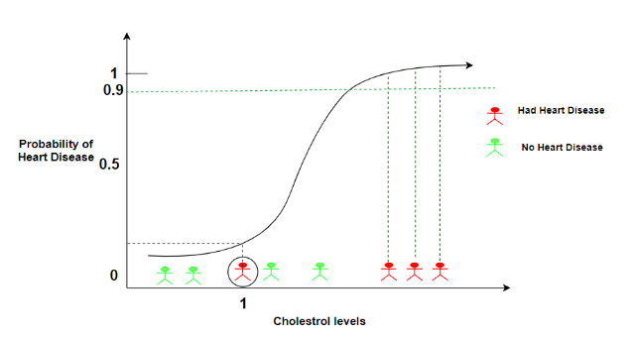
Genuine account
Probability of Genuine Accounts
Fake Account
Check List score
Genuine
Fake
Genuine
Fake
Genuine
Fake
Genuine
Genuine
Genuine
3
0
Fake
Fake
Fake
1
4

Slide 13
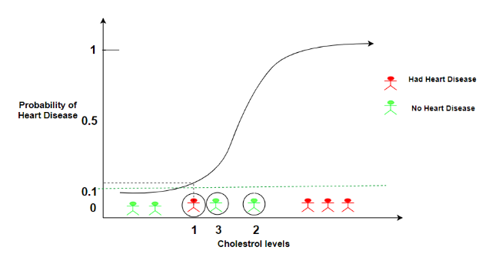
Genuine account
Probability of Genuine Accounts
Fake Account
Check List score
Genuine
Fake
Genuine
Fake
Genuine
Fake
Genuine
Genuine
Genuine
4
2
Fake
Fake
Fake
0
2

Slide 14
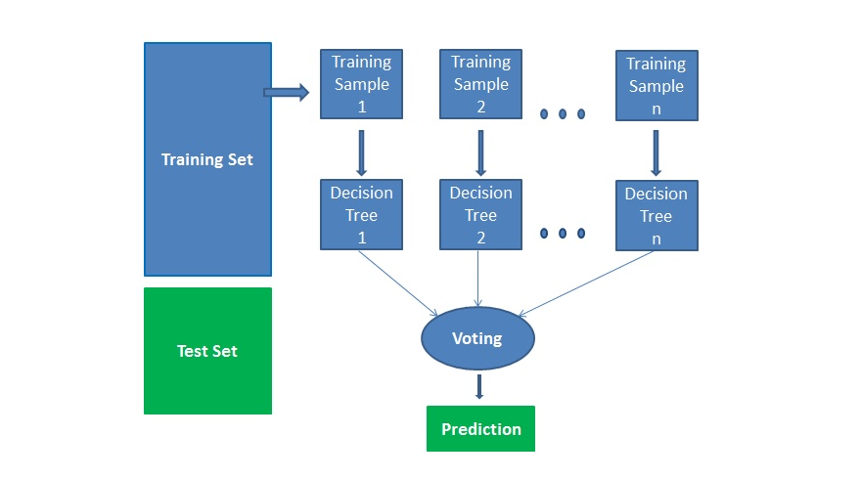
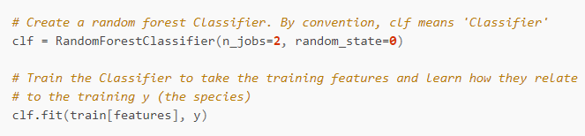
RandomForest Method:
Train Set:
From the extracted Data_set as set of samples to be taken, Random Forest classifier will be trained on the sample dataset and then confusion matrix is applied

Slide 15
Training Set:
When training, each tree in a random forest learns from a random sample of the data points.
The samples are drawn with replacement, known as bootstrapping.
Choose a number of bootstrap samples to perform
Choose a sample size
For each bootstrap sample
Draw a sample with replacement with the chosen size
Calculate the statistic on the sample
At test time, predictions are made by averaging the predictions of each decision tree.

Slide 16
Decision tree details:
Nodes | Leaves | Height
43 | 22 | 7
31 | 16 | 5
9 | 5 | 4
Tree accuracy precision recall FM MCC
1 0.979 0.984 0.974 0.979 0.953
2 0.975 0.971 0.971 0.971 0.943
3 0.964 0.957 0.957 0.957 0.914

Slide 17
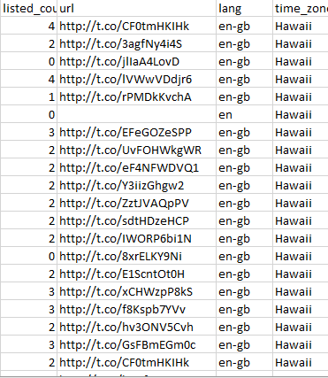
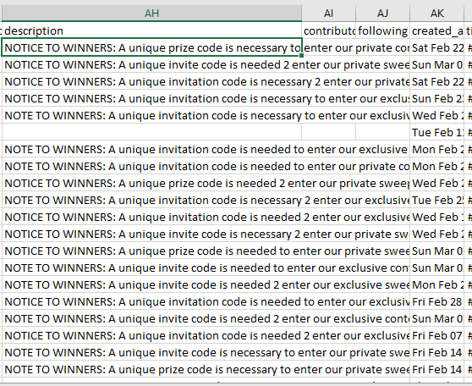
Insight of Repeated Tweet’s with URL’s:

Slide 18
Reference’s:
Journal paper:
https://www.sciencedirect.com/science/article/pii/S0167923615001803
Data Set:
http://mib.projects.iit.cnr.it/dataset.html

